Slide 1
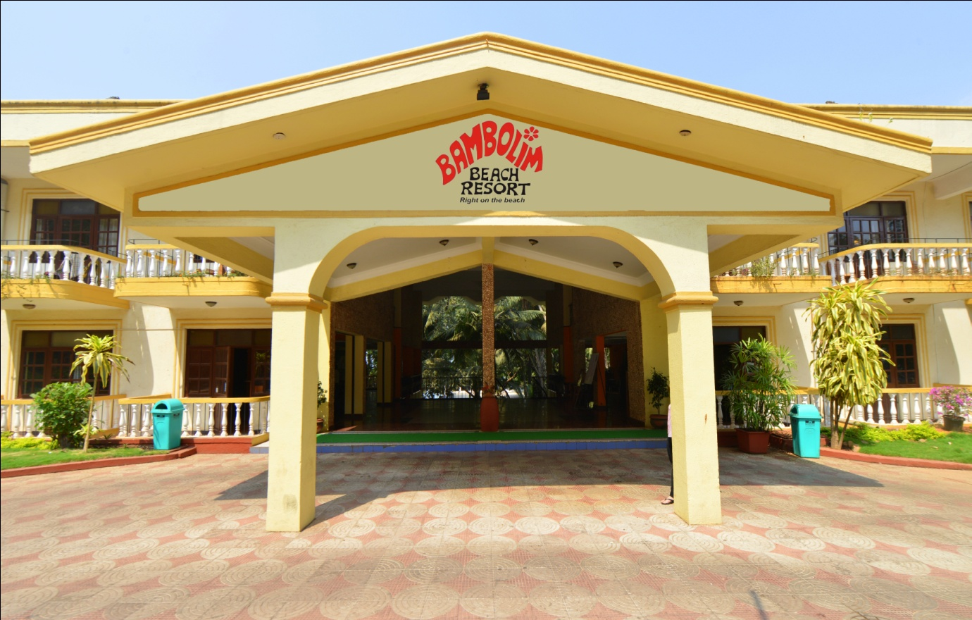
Bambolim Beach Resort

Slide 2
Bambolim Beach Resort, Goa - The name synonymous with the swaying palms, thick green foliage and unobstructed sea view. Located at Bambolim Beach within a short motoring distance to the Capital City Panjim. A perfect blend of pristine serenity of the shoreline with a backdrop of the lush Siridao hills. A true nature lover's escapade to sun, sea and the sand.

Slide 3
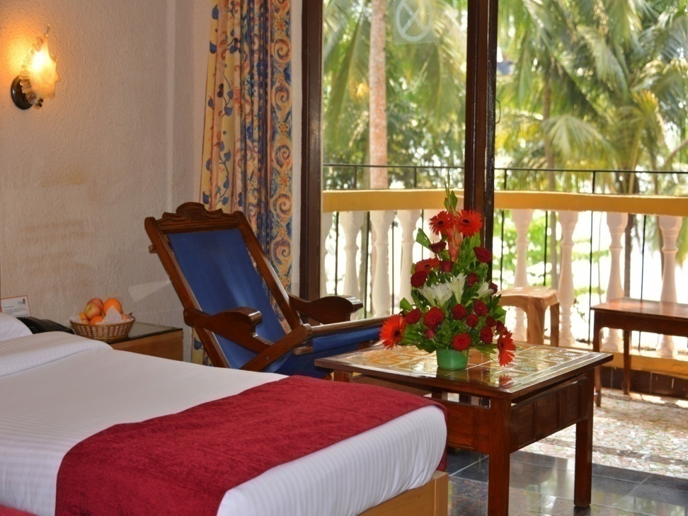
Room Types
SUPERIOR ROOMS GARDEN FACING
DELUXE ROOMS SEA FACING

Slide 4
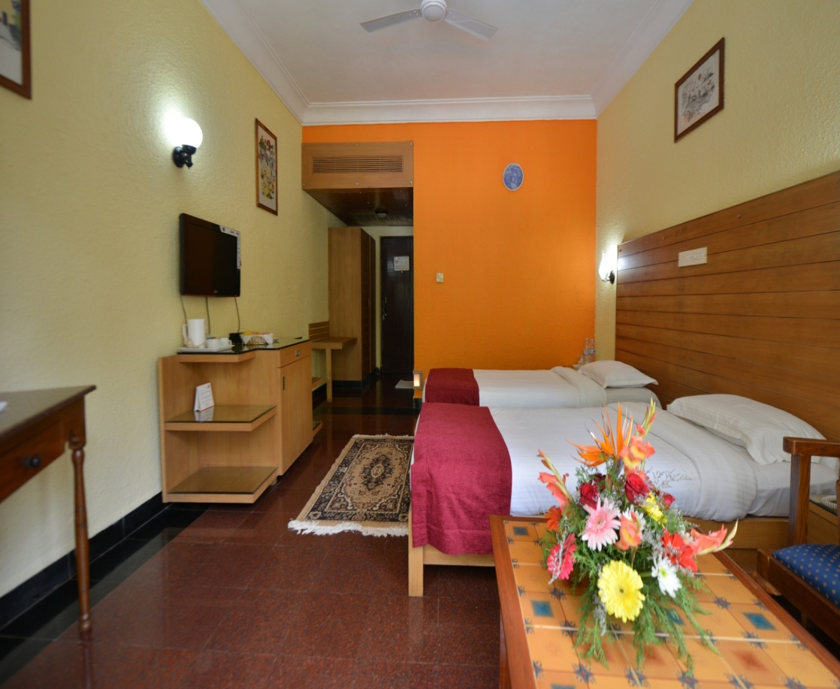
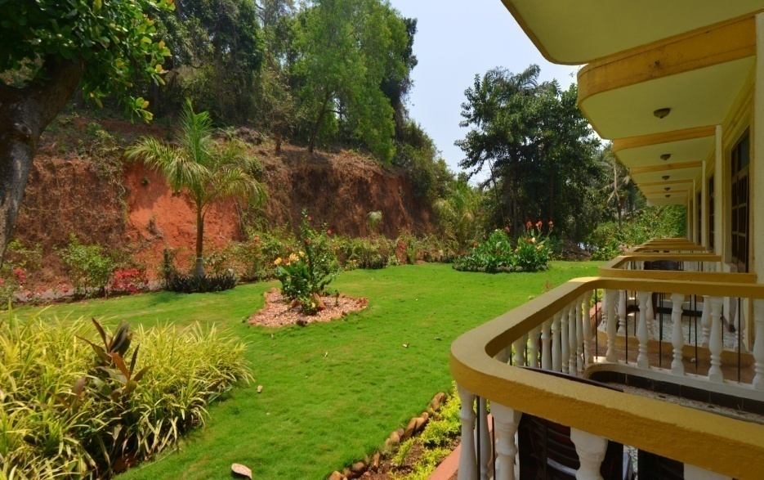
Superior Garden facing room

Slide 5
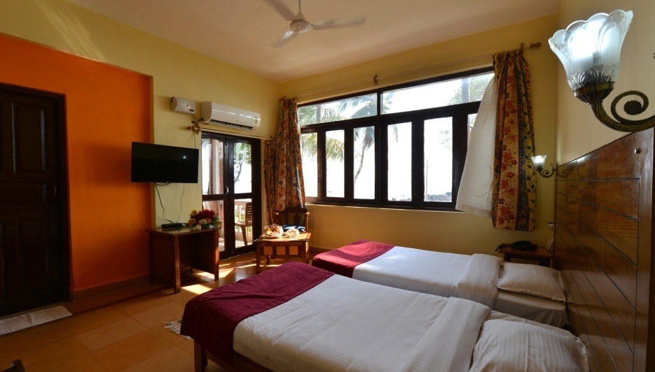
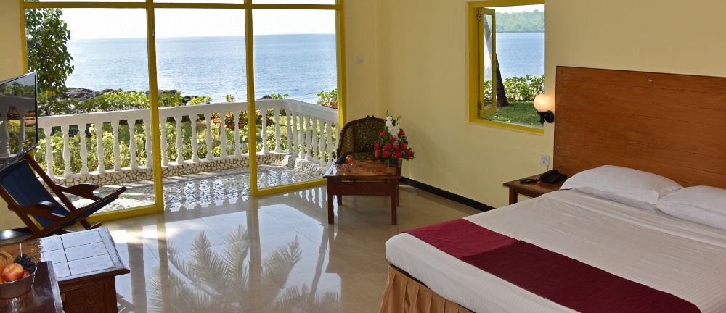
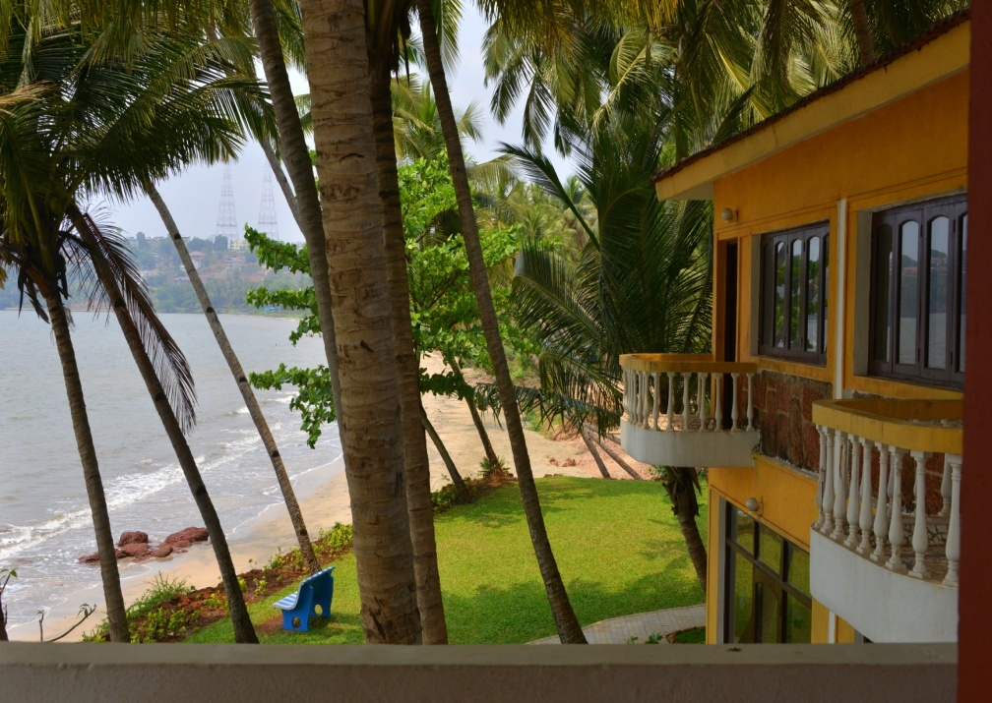
Deluxe Sea facing room

Slide 6
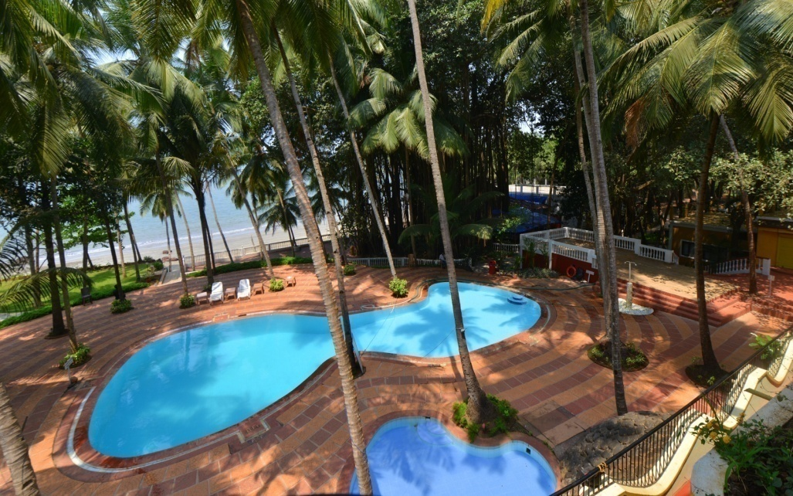
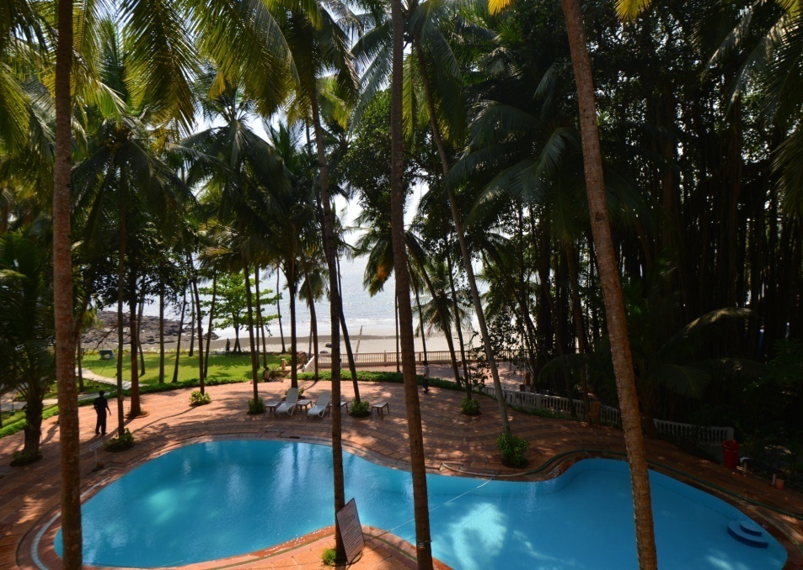
Swimming Pool
BAMBOLIM BEACH RESORT OFFERS A LUXURIOUS SWIMMING POOL WITH A SEPARATE POOL FOR CHILDREN, OUR RESTAURANT ALSO OFFERS SNACKS AND DRINKS NEAR THE POOL.

Slide 7
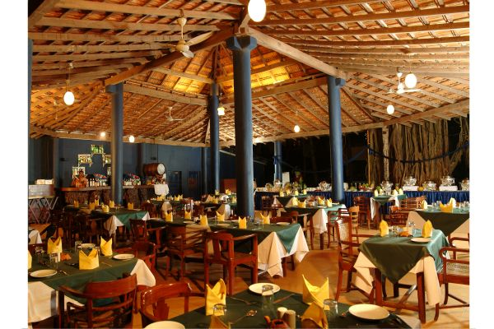
Banyan Tree Restaurant
SPECIALIZING IN MOUTH WATERING GOAN CUISINE AND SERVING CHINESE, INDIAN AND CONTINENTAL

Slide 8
BAR
FACING THE SEA ,OUR BAR OFFERS SPEACIALITY WHISKEYS THAT CATER TO EVERY PALATE, FROM HIGHLAND SINGLE MALTS TO SCOTCHES TO CLOSER TO HOME IMFL ,OUR BAR A PART OF THE BANYAN TREE RESTAURANT IS THE PERFECT PLACE TO HANG OUT WITH BUDDIES FOR A RELAXING DRINK.

Slide 9
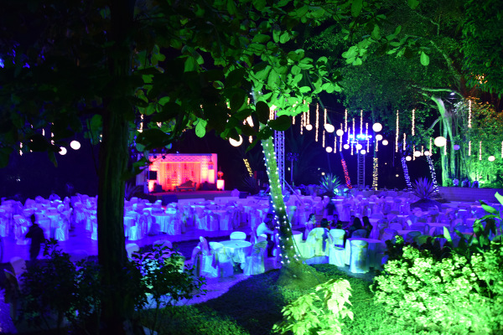
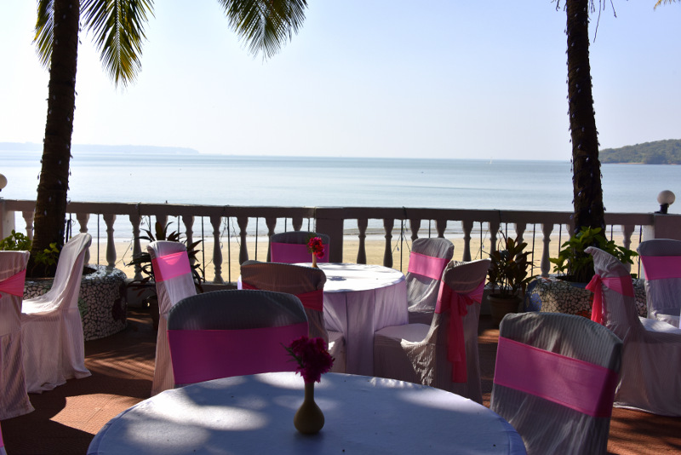
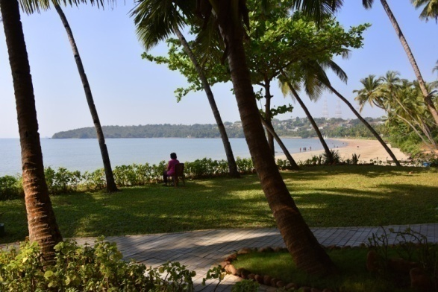
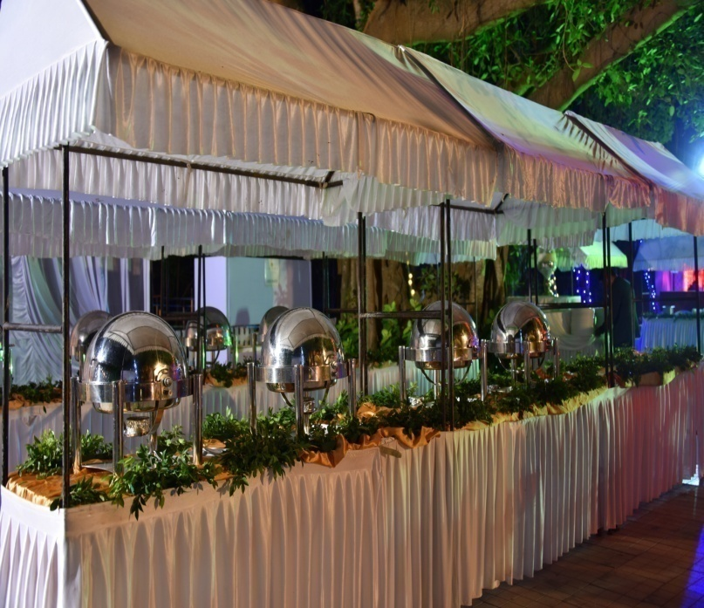
Explicit Sea Facing Venues for your Events !!!

Slide 10
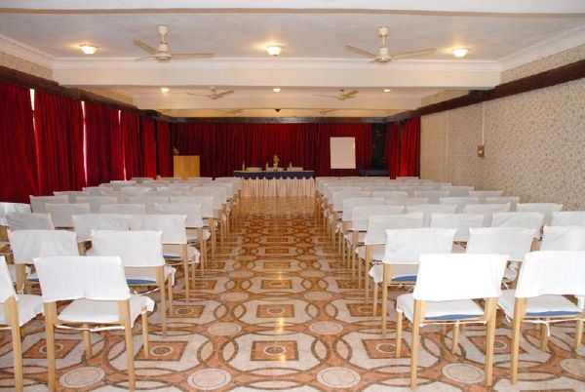
Banquets
OASIS & OCEAN PEARL - THE TWO ENCLOSED CONFERENCE FACILITIES AVALIABLE APART FROM A VARIANT CHOICE OF OPEN VENUES
CONFERENCE HALLS :- OASIS & OCEAN PEARL
OPEN AIR VENUES:- STAGE AREA , BANYAN TREE RESTAURANT , BAY WATCH, SWIMMING POOL AREA , RED TILES AREA

Slide 11
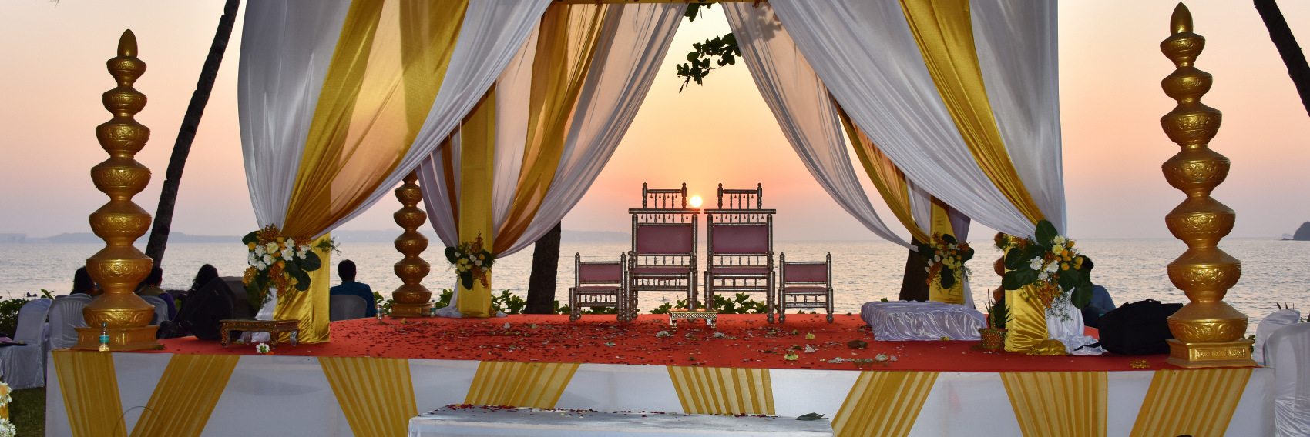
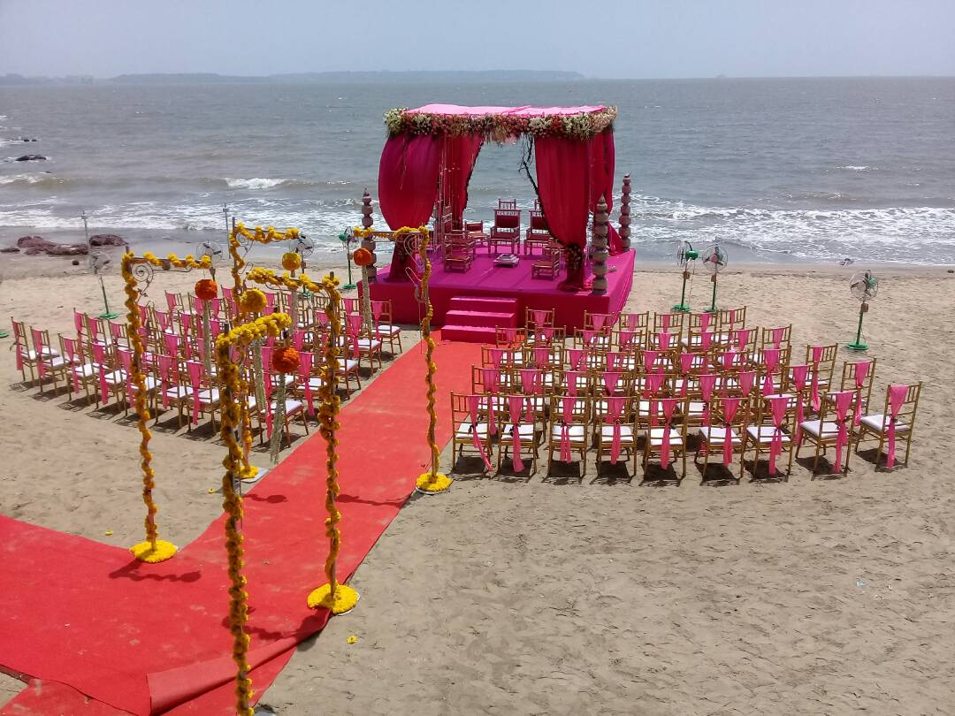
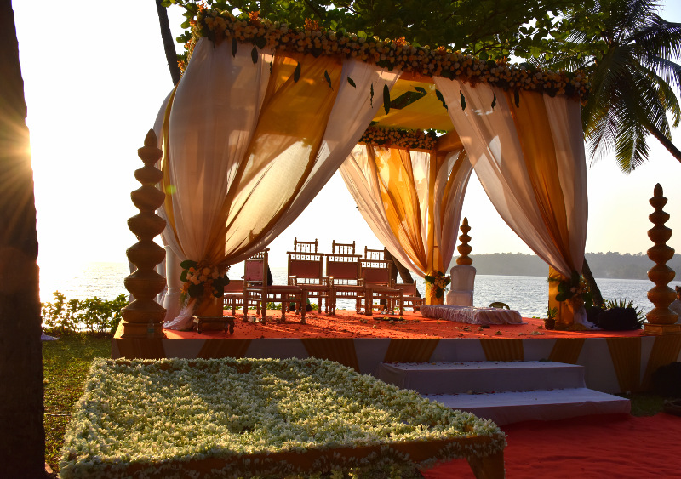
Destination Weddings
What could be better than having the sea breeze as your guest, the glory of a
vivid sunset as your backdrop, the sand under your feet and the soft swish of waves as they break against the shore?
Have your dream wedding by the sea.
We have offer you different areas for all your functions , like Sangeet Mehendi Haldi ,Cocktail party , Gala Dinner , Wedding , Reception.

Slide 12
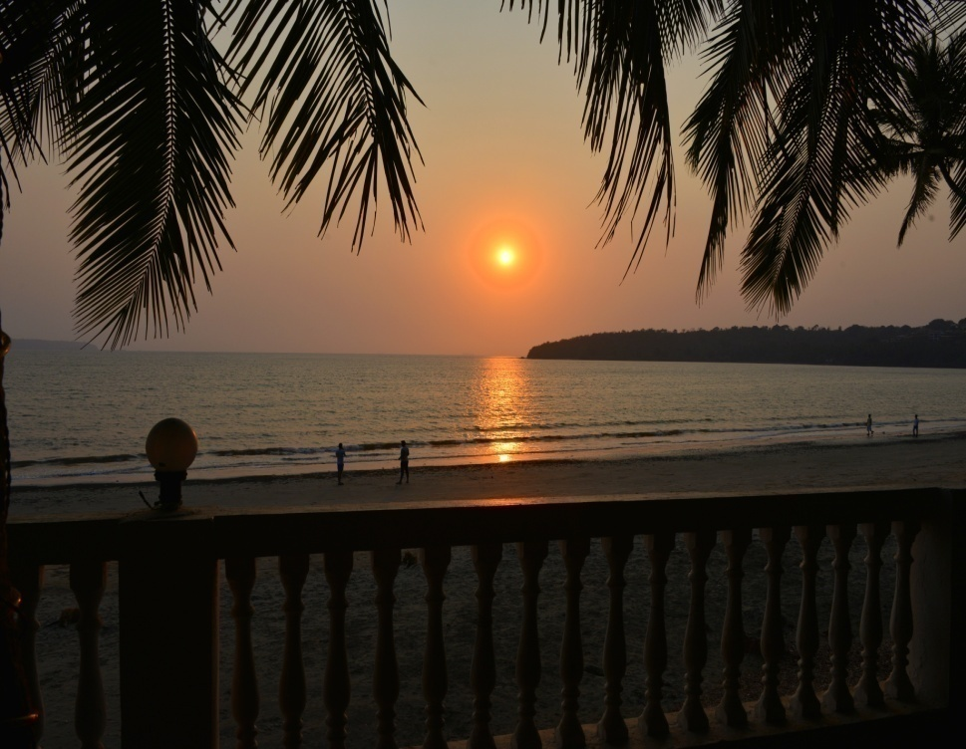
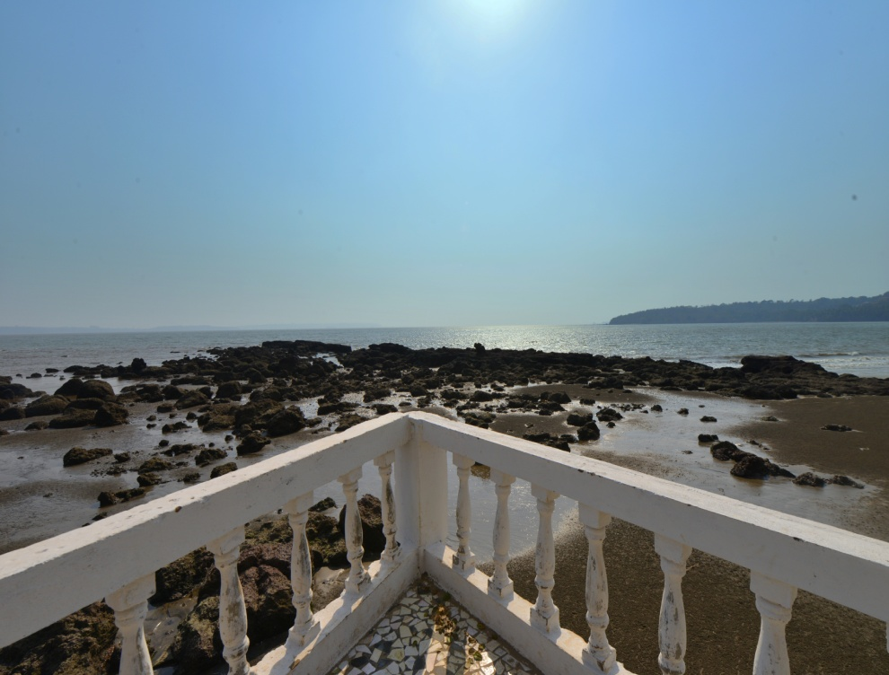
Private access to the beach

